Slide 1
Pregnancy to Parenthood Project
Presenter Name
Charity Number 701365

Slide 2
CASBA
CASBA provides advocacy support for adults with a learning disability in South Birmingham.
The Charity has been running for 33 years.
For the last 10 years, CASBA has run a successful Parents Project.
This project provided advocacy support to parents in crisis.
This included supporting parents through the child protection and court process and often sadly the removal of their children.
The funding ended for this project in 2021.

Slide 3
The next step………..
We did lots of talking to our Parents Group. It soon became clear that the majority of the parents we had worked with felt they did not have enough help when they were pregnant or as a new mom, and potentially this could have changed their journey. A bid was put together, using the knowledge we had gained from the last 10 years and backed up by the experiences of our parents peer support group. We are happy to say Big Lottery agreed to fund our project and the Pregnancy to Parenthood project was born in October 2021.

Slide 4
Pregnancy to Parenthood Project Aim
The overall aim for this project is to ensure parents with learning disabilities and their children receive the appropriate support they need during pregnancy and as new parents, so that they can develop good enough parenting skills thereby safeguarding families and reducing the risk of child protection concerns arising.

Slide 5
The Project will offer
Families will be offered intensive support for the first six months which will reduce as the family grows in skill and confidence.
1 – 1 advocacy support to parents with children under 5 or women who are pregnant. Through 1-1 support we hope to increase access to parenting support and community services. We will also support families in a holistic way and ensure all aspects of family life are addressed eg housing, health and income.
Access to fortnightly peer support group to help reduce isolation
Access to Freedom Programme, to increase understanding of domestic violence and the impact on the children.
Access to self-advocacy workshops to increase self-esteem and confidence.
Accessible recipes and information to encourage healthy eating
Signposting to other services
Referrals to other local services
Form filling
Support to make phone calls
Emotional support
Access to Parents Facebook group – to help reduce feelings of isolation

Slide 6
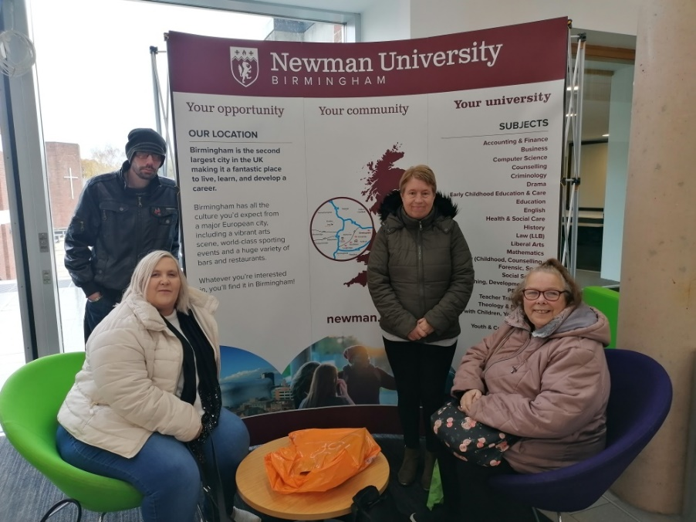
Voices of the Parent’s Training
Up until last year CASBA has provided training to students. This training was one parents dream, of wanting to help parents that came behind her. She wanted them to have a different experience to what she had.
Voices of the parents was an information workshop created and delivered by parents with a learning disability to health and social care and social work students.
This training aims to help students understand the needs of a parent with a learning disability. Parents shared each others own stories and then gave helpful information on how to work with a parent with a learning disability in a meaningful way.
The students who attend these workshops gave positive feedback and many said it would change the way they worked in the future.

Slide 7
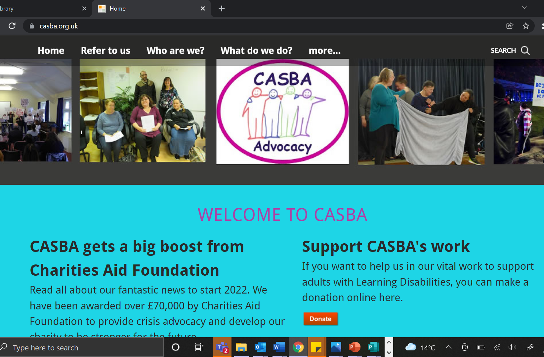
Voices of the parent’s – the next step..
As part of the new pregnancy to parenthood project we have decided to create a new training website, which will hopefully be up and running later this year.
This website will contain the original” Voices of the parents” training material alongside even more easy read resources, information and case studies.
We hope to be able to reach more students and professionals by creating this website.

Slide 8
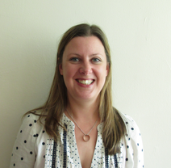
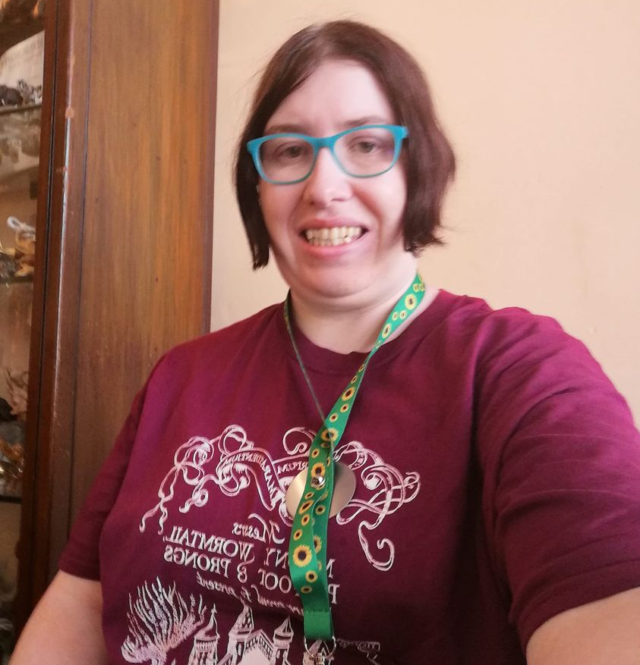
Our Staff
Tracy Morris Alyson McMillan Jennifer Brown
Parents Advocate Parents Advocate Project Assistant

Slide 9
Project Criteria
Has a learning disability
Is over 18
Lives in South Birmingham
Is pregnant, a new mom or has a child/children under 5
Referral
If you would like to make a referral, please go to our website – www.casba.co.uk and fill in the referral form.
If you do not have access to the internet, please call 0121 475 0777 and speak to Tracy or Alyson.

